Slide 1
IST687 – Applied Data Science
Data & Data Frames

Slide 2
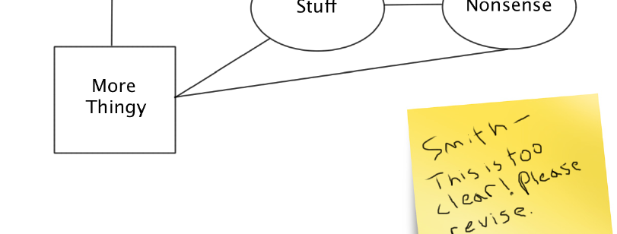
Data Science: Following the Data
An old adage in detective work is to, "follow the money." In data science, one key to success is to "follow the data." In most cases, a data scientist will not help to design an information system from scratch. Instead, there will be several or many legacy systems where data resides; a big part of the
challenge to the data scientist lies in integrating those systems.

Slide 3
Data Science
Context for more functional use of R
Systems Analysis & Design 101
Process Model (Data Flow Diagram)
Data Model (Entity Relationship Diagram)
Data Model (Star Schema)
Graphical User Interface (GUI)
Reference to the “Systems Type” pyramid

Slide 4
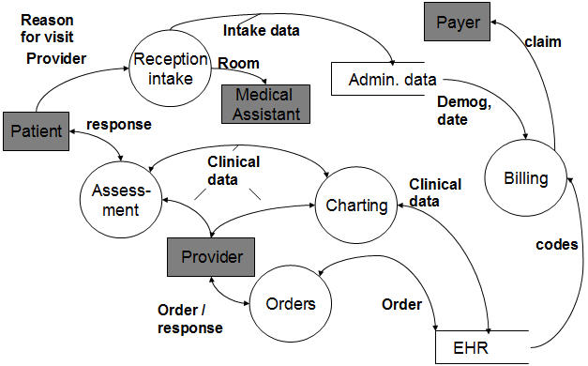
Data Science
Data Flow Diagram (DFD)

Slide 5
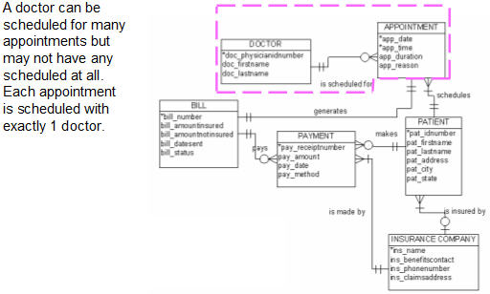
Data Science
Entity Relationship Diagram (ERD)

Slide 6
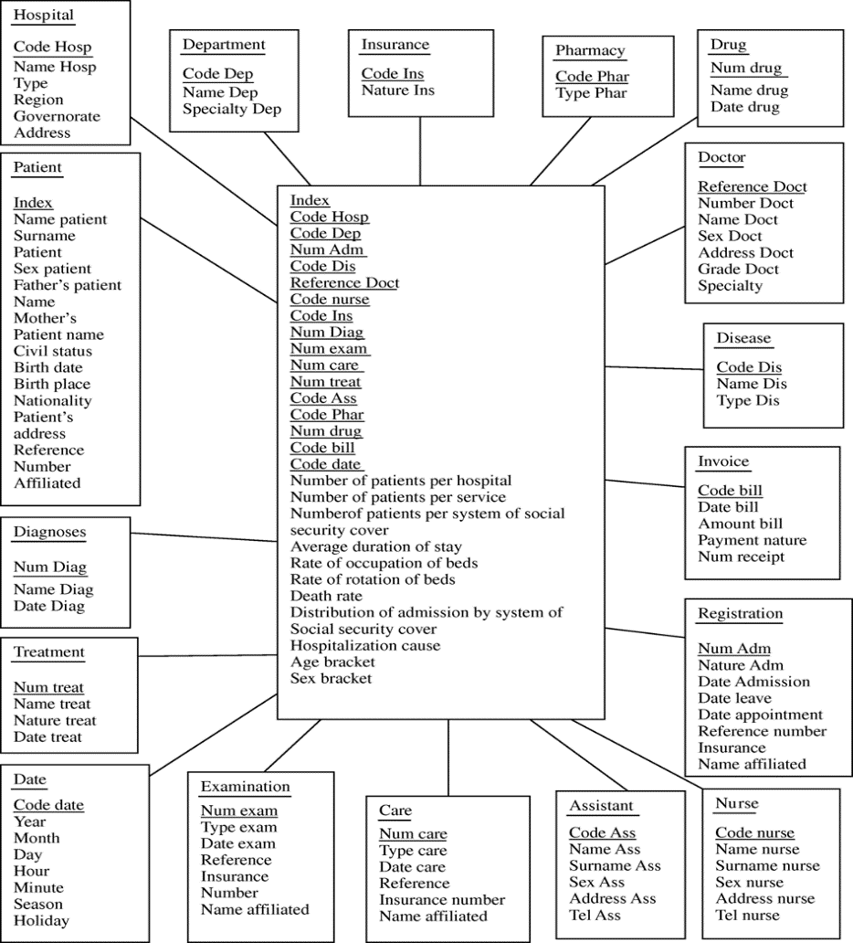
Data Science
Star Schema

Slide 7
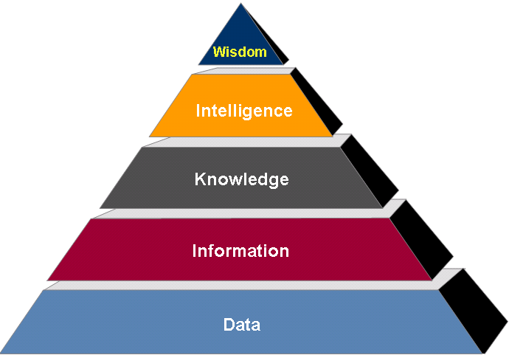
Data Science
Information Systems Types
Analytics
Executive Information Systems (EIS)
Decision Support System (DSS)
Management Information System
Transaction Processing System

Slide 8


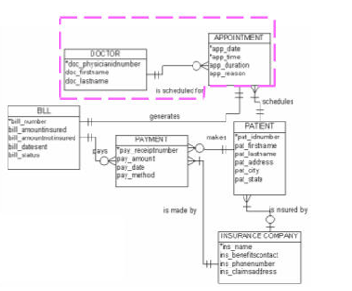
Data Science
Information Systems Types
Analytics
Executive Information Systems (EIS)
Decision Support System (DSS)
Management Information System
Transaction Processing System

Slide 9
Data Science
Key ‘take away’
Data Modeling
Technique for organizing data and demonstrating relationships among data
A context and precursor for a more robust use of R functionality i.e. the data frame
Describe and represent enterprise and subject area domains

Slide 10

Data Science: Rows and Columns
One of the most basic and widely used methods of representing data is to use rows and columns, where each row is a case or instance and each column is a variable and attribute. Most spread sheets arrange their data in rows and columns, although spreadsheets don’t usually refer to these as cases or
variables. R represents rows and columns in an object called a data frame.

Slide 11
Data Science
Know your data
Context
Content
Mode
Data organization to facilitate “R” analysis
Rows & Columns
Consistent mode type by attribute/variable

Slide 12
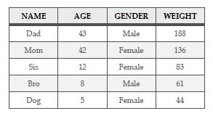
Data Science
Dataset
context

Slide 13
Data Science
Dataset – Characteristics
2 dimensional rows & columns

Slide 14
Data Science
Dataset – Characteristics
2 dimensional rows & columns
Rows (data)
Cases
Instances
Observations
Note: Name Age Gender Weight is not a data row

Slide 15
Data Science
Dataset – Characteristics
2 dimensional rows & columns
Columns (data)
Attributes
Variables
Variable Name
Note: Name Age Gender Weight are not data

Slide 16
Data Science
Dataset – Characteristics
2 dimensional rows & columns
Columns (data)
Variable Name
Attributes
Variables

Slide 17
Data Science
Dataset – More Characteristics
Each row has a unique identifier (case label)

Slide 18
Data Science
Dataset – More Characteristics
Each column has the same type/mode of data
Each column has the same number of entries

Slide 19
Data Science
Dataset – How does this get built in “R”
Create a vector for each variable (column)
Create a data frame to combine individual vectors

Slide 20
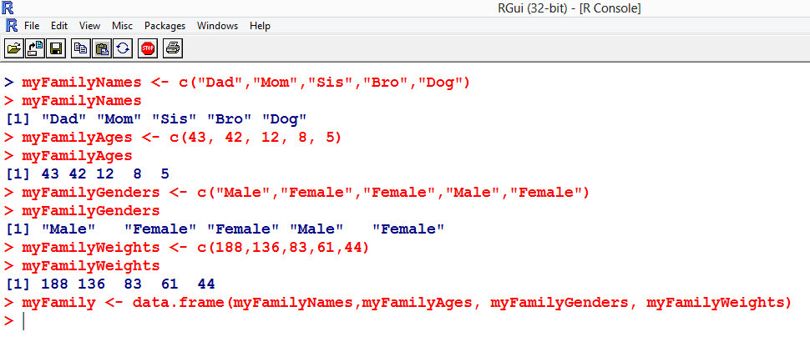
Data Science
The respective variable columns have been built as vectors and displayed below
The respective variable columns have been combined and assigned a label via the data.frame function

Slide 21
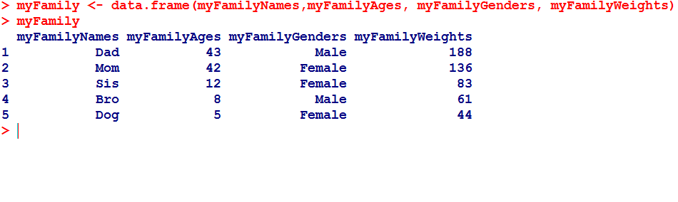
Data Science
Display the contents of the data object MyFamily

Slide 22
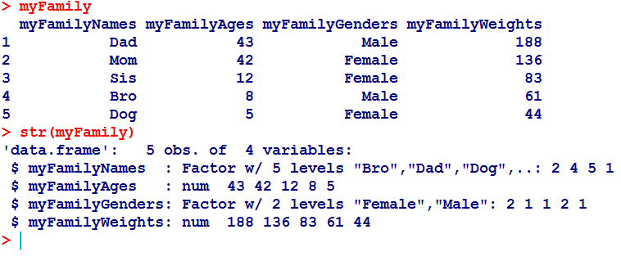
Data Science
Display the data object MyFamily using the “R” structure function
What does the structure function tell us about the data object myFamily ?
Confirmation that MyFamily is a data frame, it has 5 observations (cases/instances) and 4 variables
“$” for each variable /component column with descriptive information
Each of the 4 variables has a mode or type (the same mode within a variable/column)
Variable is either a “factor” or “num”
“Factor” variable has a “level”
“Level” describes the options within a variable
“num” variable indicates “numeric”

Slide 23
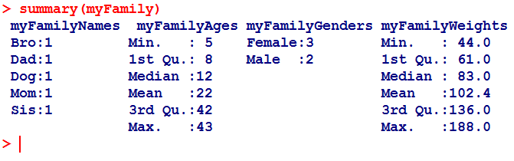
Data Science
Display the data object MyFamily using the “R” summary function
What does the summary function tell us about the data object myFamily ?
“Factor” variables list variable names (MyFamilyNames, myFamilyGenders, MyFamilyWeights) along with the number of occurrences of cases that are coded within that factor
Numeric variables have 6 different calculated quantities that help summarize the variable
Min – minimum or lowest value of all cases
1st Qu – dividing line at the top of the 1st quartile
Median – value of the case that splits the whole group in half
Mean – numeric average
3rd Qu – 3rd quartile
Max – max value of all cases

Slide 24
Data Science
Accessing Dataframes as a matrix
> myFamily[1,1] <- returns the data element in the first row and first column
> myFamily[1,] <- returns the first row
> myFamily[,1] <- returns the first column
> myFamily[-1,] <- returns everything but the first row (i.e. deletes the first row)
> myFamily[,-1] <- returns everything but the first

Slide 25
Data Science
“R” take-aways
A vector is a list of elements/things that are all of the same kind (mode)
Analysis of data sets/data objects are in a rectangular format i.e. rows & columns
A data frame is used to store theses rectangular data sets / data objects
The data.frame function organizes vectors into a data frame
The str() & summary() functions reveal the structure and content of a data frame
A factor is a labeling system used to organize groups of cases or observations
Quartiles are a division of a sorted vector into 4 evenly sized groups
Min and max functions are used to identify the min and max values in a vector
Mean and median used to measure “central tendency”

Slide 26

Data Science
So,,,,
ev up your engines
More to come in our next chapter segment

Slide 27
IST687 – Applied Data Science
End of Data and Data Frames

